Slide 1


iTechArt
Group
2022
itechart.com

Slide 2
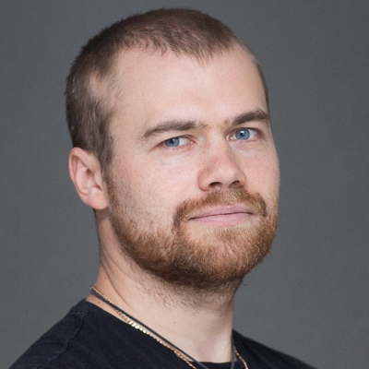
Lector
Anton Nekrasov
Contact information
Curator & Department Manager, U1.Div1.D1
Phone: +375 29 330 97 29
Email: anton.nekrasov@itechart-group.com

Slide 3
Software Development Processes
2022
itechart.com

Slide 4
Plan
• Main concepts and project development methodologies
• Teamwork
• Task management tools

Slide 5
Presentation
What is Project Management
2022
itechart.com

Slide 6
Definition
Project management is the process of leading the work of a team to achieve all project goals within the given constraints

Slide 7
PDCA Scheme
Plan
Do
Check
Act

Slide 8
Presentation
Software development models
2022
itechart.com

Slide 9
Waterfall
• Strictly defined phases
• Each new phase starts only after the previous one ends
Requirements Analysis
System Design
Implementation
Testing
Deploy
Support

Slide 10
Waterfall Pros & Cons
Pros
Cons
Potential issues can be eliminated at the design stage
Waterfall projects are usually more documented
Linear process is more clear for the engineers
The customer usually has the idea but does not see the full product. Waterfall does not solve this problem
The design can look logical at the design stage, but may appear to be too expensive and labor intensive at the implementation stage
Making any amendments is very expensive
A clear separation of development stages implies a fairly clear delineation of roles

Slide 11
Agile Model
• Iterative approach
• Each iteration ends with a finished product
• The main accent is made on the self-organizing teams
Iteration #1
Planning
Iteration #2
Planning
Iteration #3
Planning
Implementation
Testing
Deploy
Implementation
Testing
Deploy
Implementation
Testing
Deploy

Slide 12
Agile Pros & Cons
Pros
Cons
Working project at the end of each iteration
More transparent collaboration between client and development team
Changes are allowed at any development stage
Continuous improvements of the existing system/process are possible
Development process is almost completely transparent
Agile methodologies (Scrum, XP, Kanban) are more difficult to understand
Lack of documentation
Tend to be counterproductive for large organizations

Slide 13
Agile or Waterfall?
Waterfall
Agile
Requirements are clear and won’t be changed in the future
The project is pretty simple and the risks are minimal
The team is not experienced enough
Requirements are not clear and/or might be changed
If the product is intended for a market with constantly changing standards
The team is pretty experienced and is ready to adapt to a nonstandard circumstances

Slide 14
Presentation
Scrum
2021
itechart.com

Slide 15
Definition
Scrum is an agile project management framework, which describes a set of meetings, tools, and roles that work in concert to help teams structure and manage their work

Slide 16
Structure
Roles
Product Owner
Development Team
Events
Sprint Planning
Retrospective
Scrum Master
Daily Scrum
Sprint Review
Artifacts
Increment
Product Backlog
Sprint Backlog

Slide 17
Sprint
• The product is being developed in a series of sprints
• Recommended length is 4 weeks
• Strictly limited in time
• Product is designed, coded, tested in one sprint
• Finished product at the end of each sprint

Slide 18
Roles
• Product Owner – knows the requirements, priorities, deadlines, accepts work
• Scrum Master - responsible for implementing practices, team effectiveness, eliminating obstacles, ensuring transparency
• Development Team – crossfunctional team (software engineers, QA, designeers, devops etc.) responsible for the result

Slide 19
Events
• Sprint Planning – kick starts each sprint, where the team discuss, which items will be included in sprint
• Daily Scrum – daily sync meeting, no longer than 15 minutes, where the team shares the progress, plans and blockers
• Sprint Review – usually takes place on the last day of the sprint, and allows the team to show the completed product increment to the stakeholders
• Sprint Retrospective – event, where the team reviews, what can be improved, and how they should do it

Slide 20
Artifacts
• Increment – potentially releasable product at the end of each sprint
• Product Backlog – the product backlog is an ordered list of everything that is known to be needed in a product
• Sprint Backlog – the sprint backlog is a list of everything that the team commits to achieve in a given sprint

Slide 21
What is NOT Scrum?
• Contradictions with Agile ideology (manifesto)
• Absence of iterations
• Lack or ignorance of feedback
• Lack of prioritized tasks backlog
• Absence of transparency

Slide 22
Presentation
Task Management Systems
2022
itechart.com

Slide 23
Popular Task Management Systems
• Jira
• Trello
• Redmine
• TargetProcess
• Wrike

Slide 24
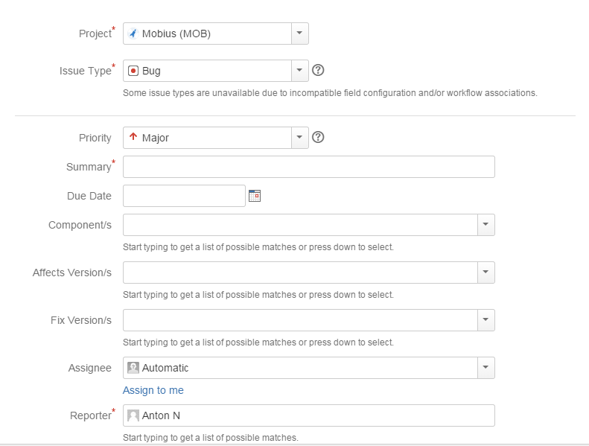
Task

Slide 25
Task Fields
• Type
• Summary
• Description
• Priority
• Due Date
• Status
• Original Estimate
• Assignee
• Fix Version
• Affected Version

Slide 26
Which Task To Choose?
• Tasks with highest priority
• Tasks assigned personally on the developer
• Tasks assigned to the current iteration/sprint/fix version
• Tasks with expiring due date
• Other things being equal, bugs are more important than features

Slide 27
Task Life Cycle
• Product backlog
• Sprint backlog
• In Progress
• Blocked (optional)
• Ready for Review • Ready for Testing
• Ready for Deploy
• Done

Slide 28
Work on the Task
• Make sure the task is estimated
• Estimate includes all the time, spent on the task, including investigation, development, testing and merge
• Original estimate cannot be changed
• After the task is done, time spent and status should be updated

Slide 29
Recommendations
• Task should not take more than 8 hours, otherwise it should be split into smaller ones
• One commit should not contain solutions for multiple tasks (except cases, where the same code really solves more than one problem)
• Engineer should not have more task in progress at a time
• Task description of the task should not contain lots of the technical terms in it (use developer notes section instead)
• Ignoring regular task status updates might block other parts of the development chain

Slide 30
Tasks Estimation
Types
Units
Expert Estimation
Hours
Planning Poker
Story Points

Slide 31
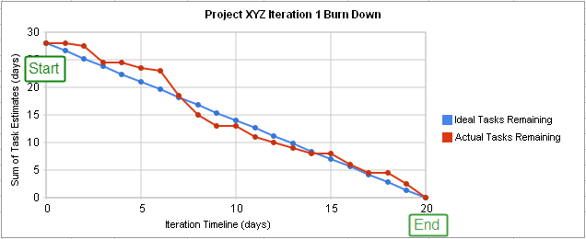
Burn down Charts

Slide 32

Thank you!
2021
itechart.com

